Slide 1

BUSINESS INSIGHTS 360
ATLIQ HARDWARE TECHNOLOGIES
Presented by : A.Pydi Raju

Slide 2
About AtliQ
AtliQ Hardware is a global electronics company where it manufactures hardware components such as:
Notebooks – Personal Computer, Gaming, and Business laptops.
Peripherals – Processors, Graphic Cards, Motherboards, Internal HDD.
Accessories – Keyboards, Mice, Batteries.
Storage & Networking – SSDs, USBs, Wi-Fi extenders, and more.
🌍 With a strong international presence across North America, Latin Aerica, APAC, and the EU Region

Slide 3
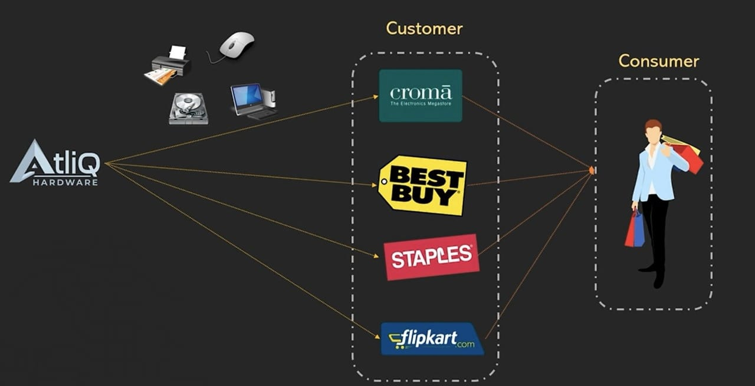
AtliQ Business Model

Slide 4
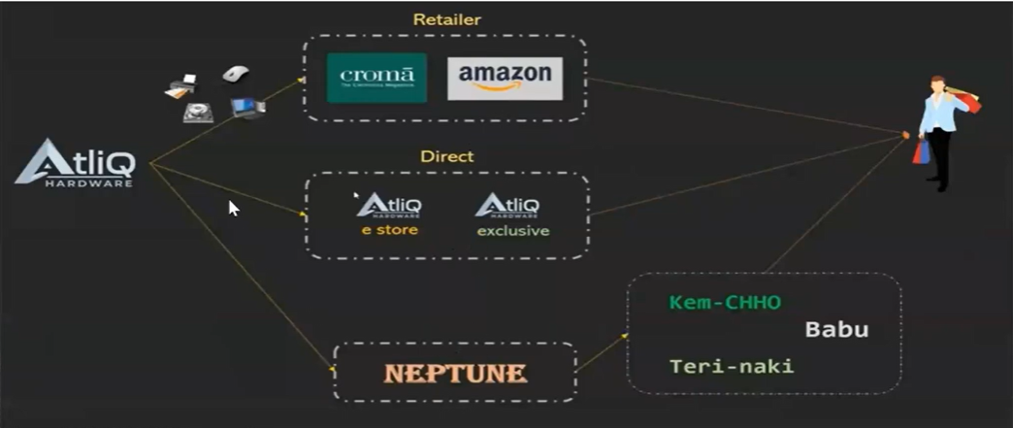
AtliQ channel

Slide 5

Problem Statement
Atliq hardware has faced a significant losses because they have opened a New Store in latin America region without having Sufficient Information.
Goal
The company aims to look at the data from different departments, make important metrics and visuals and make a easy to use dashboard for better data driven decision making.
Objective
To keep up with competitors who already rely on advanced analytics, the company decided to leverage Power BI for making data-driven decisions.

Slide 6
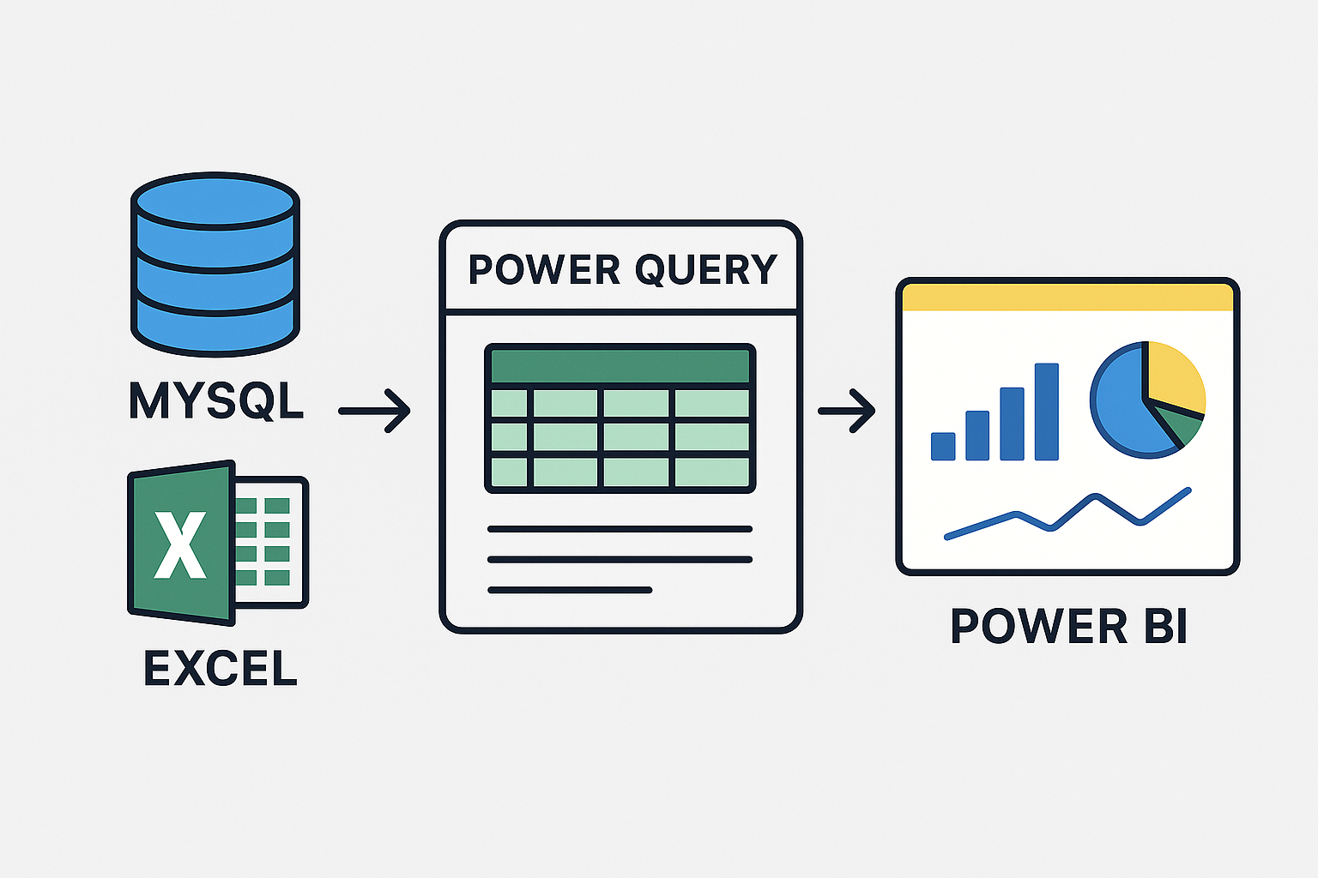
Data

Slide 7
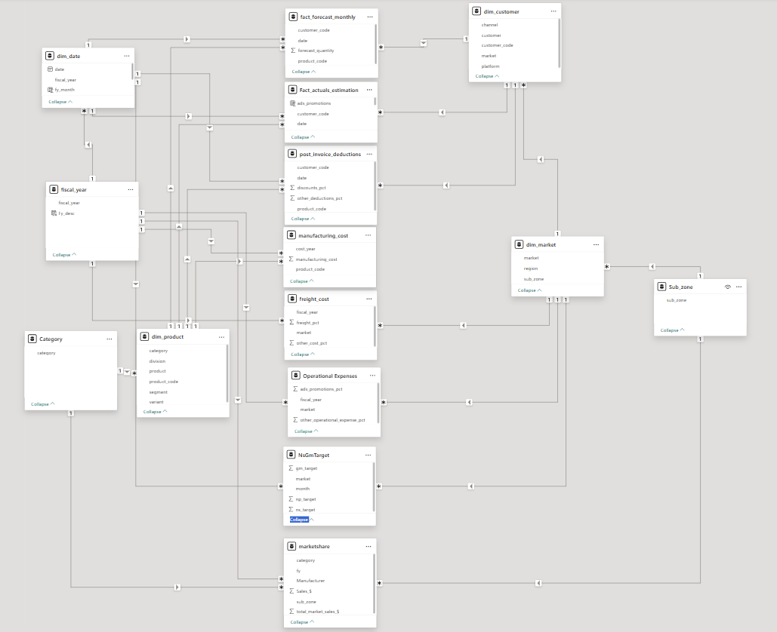
Data Model

Slide 8
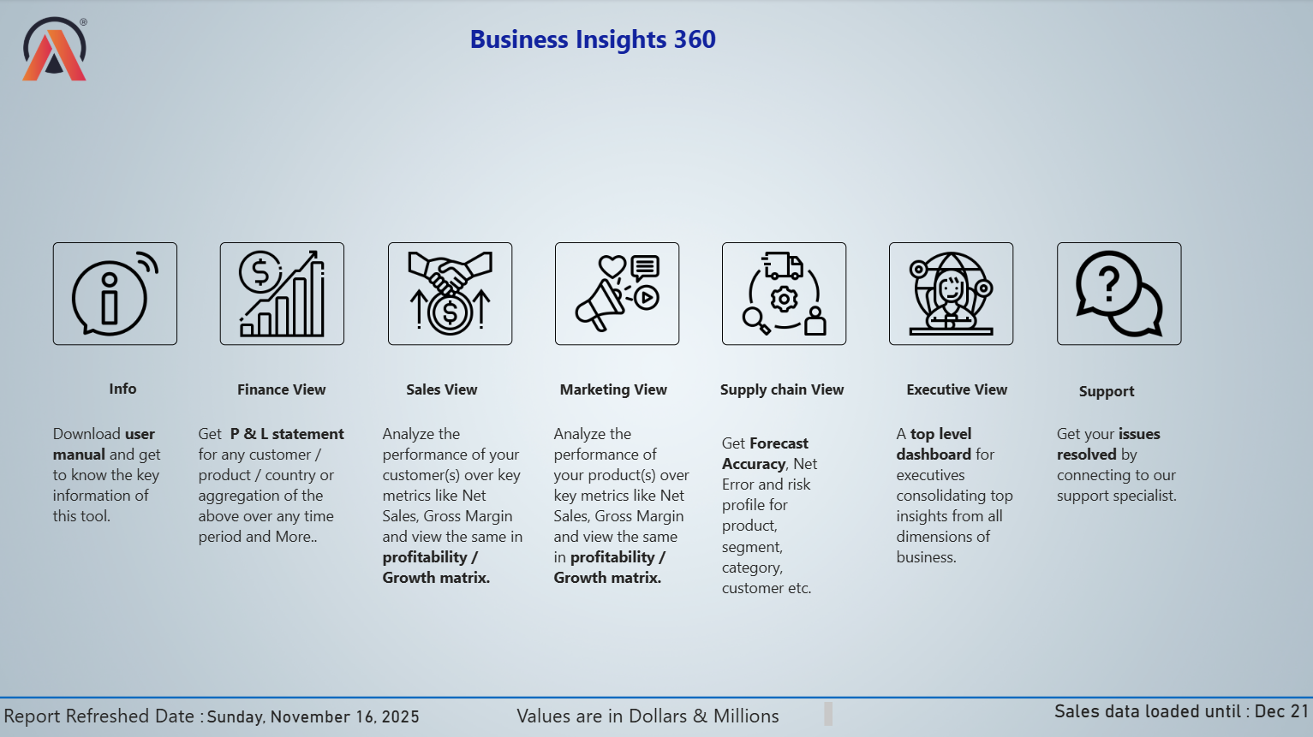
HOME PAGE

Slide 9
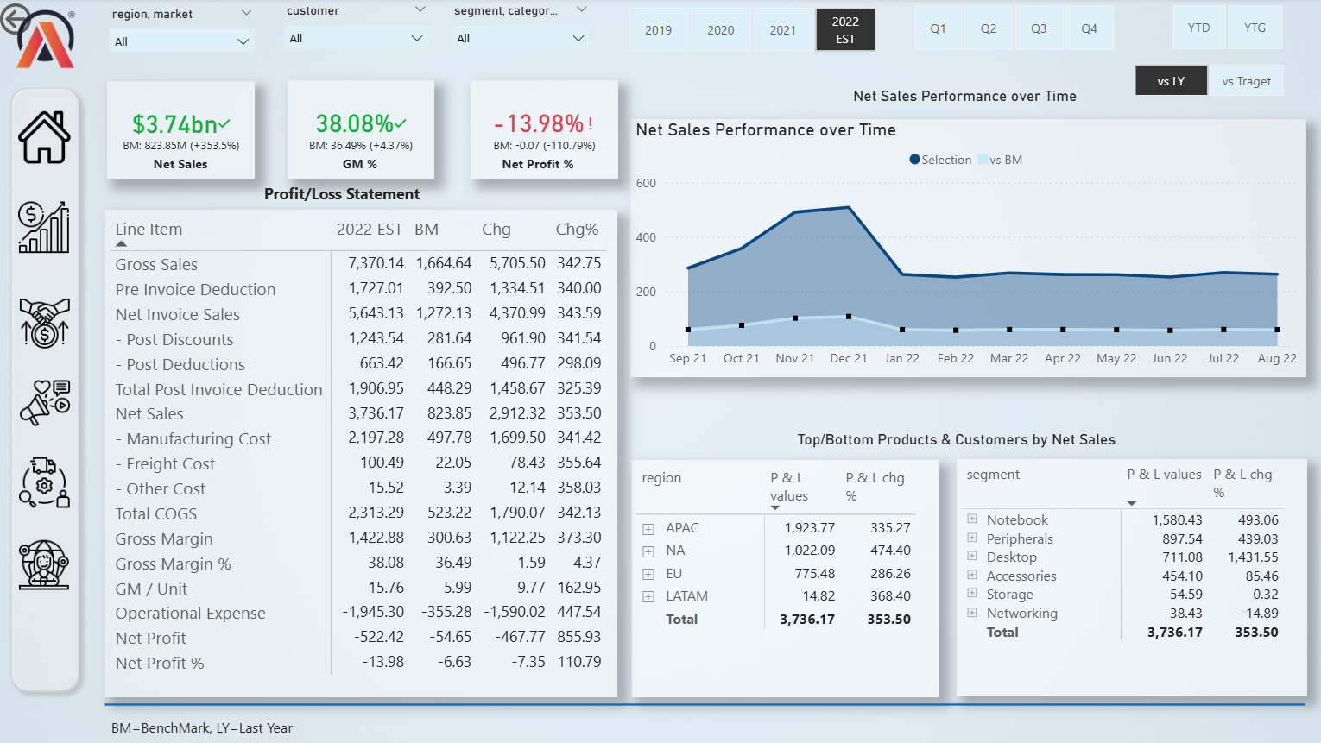
Finance View

Slide 10
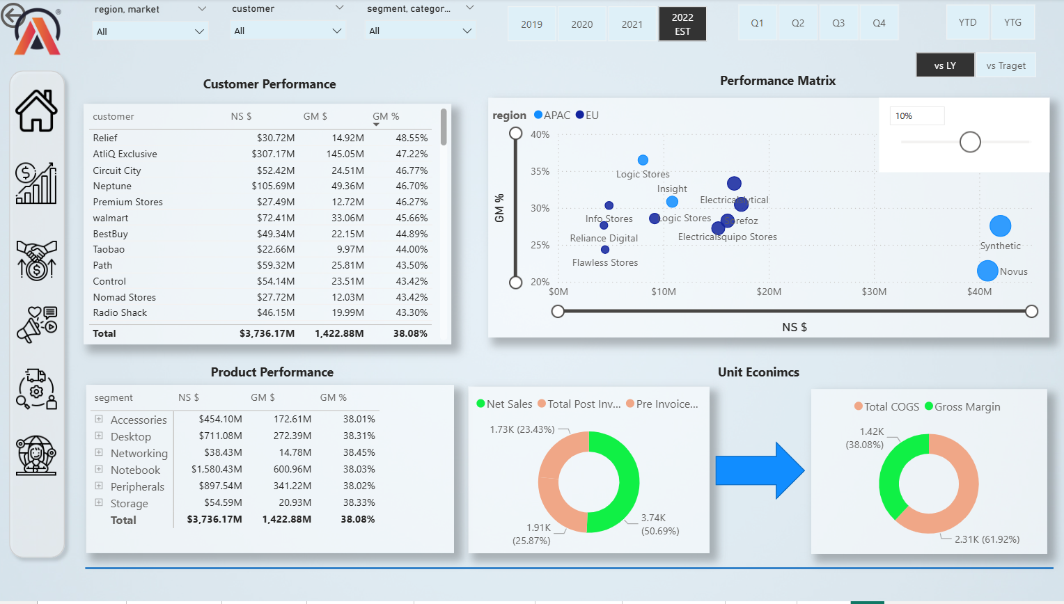
Sales View

Slide 11
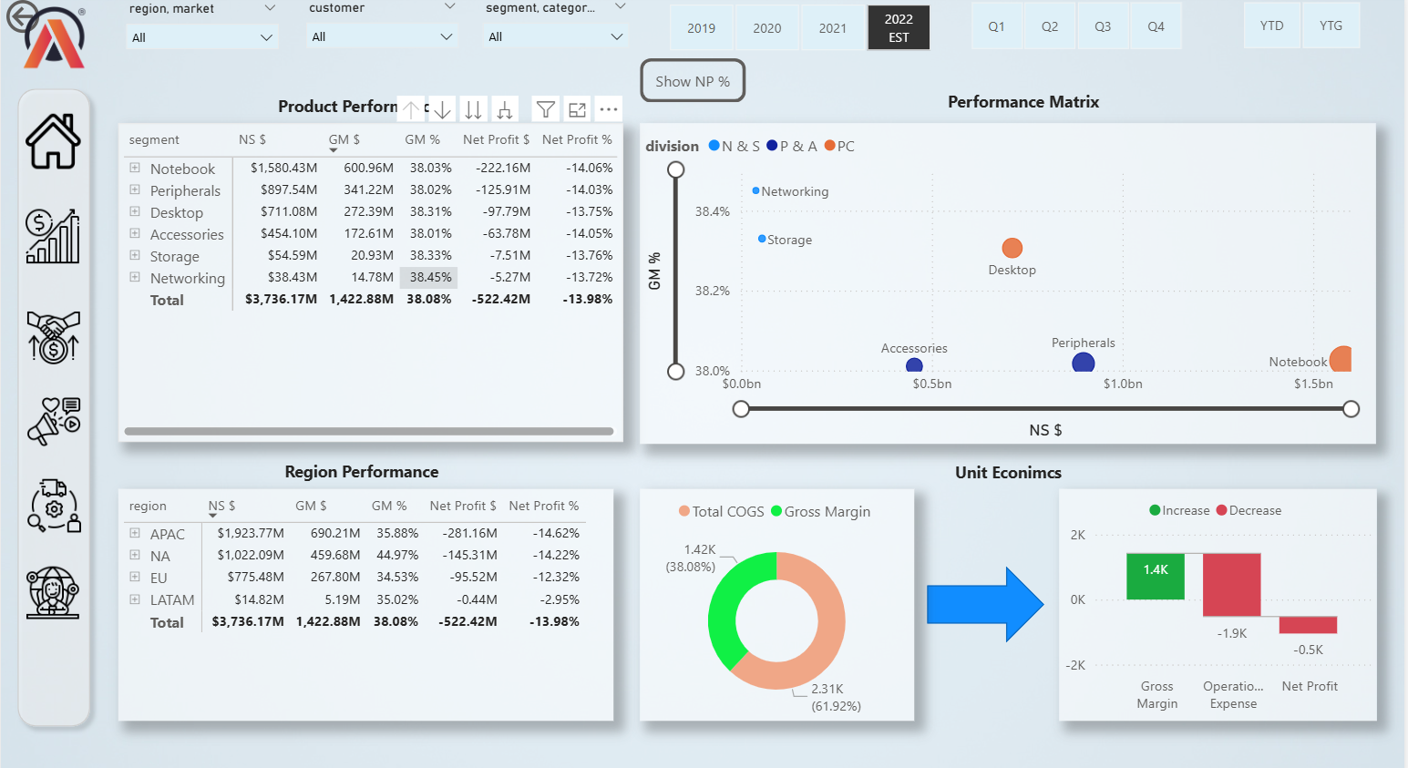
Marketing View

Slide 12
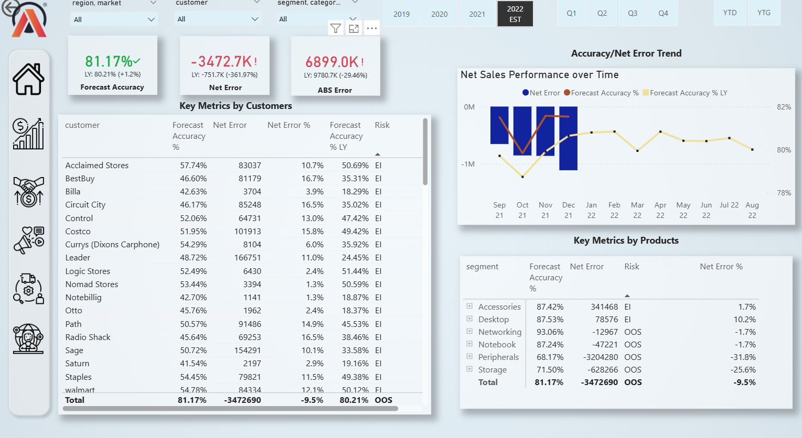
Supply Chain View

Slide 13
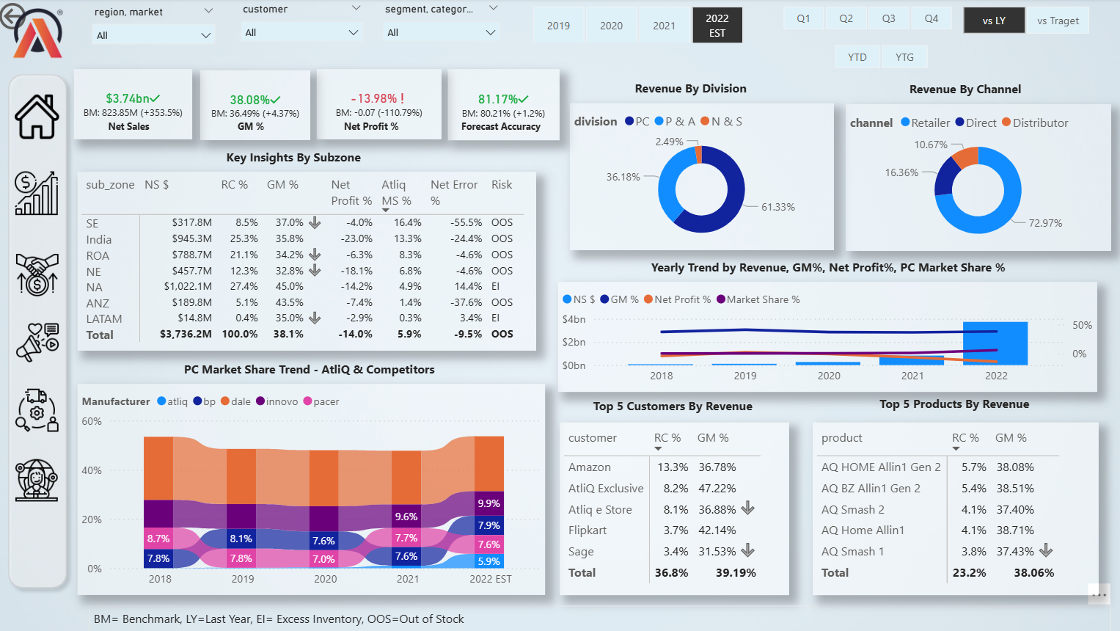
Executive View

Slide 14
Key Insights
Atliq has facing Financial challenges due to high Expenses on discounts and operational expenses leads to overall loss
“Amazon” customer and “AQ Home Allin1 Gen 2”product excels in market .so they should follow the same strategy to all customers and products
USA segment reports losses, requiring detailed investigation for strategic decisions.
AtliQ Hardware Market Share from 1.1% in 2021 to 5.9% in 2022 having positive Signals in Market Expansion

